Slide 1

Jose Naranjo (胡塞)
presenter
2020- 2021
school period
形式语言与计算理论
时间复杂度应用：投票系统
Time Complexity Application: A voting System

Slide 2
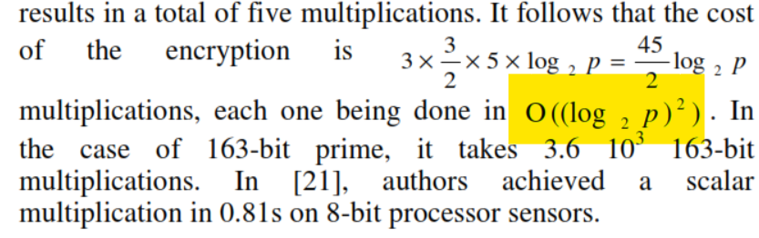
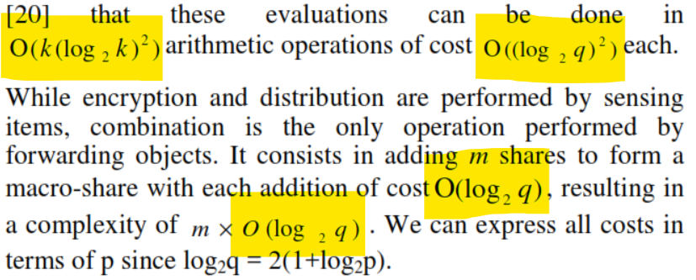
Complexity Theory
Complex theory studies how the computational cost grows mainly in memory and time
when solving a problem with relation to how the size of the problem grows

Slide 3


Slide 4
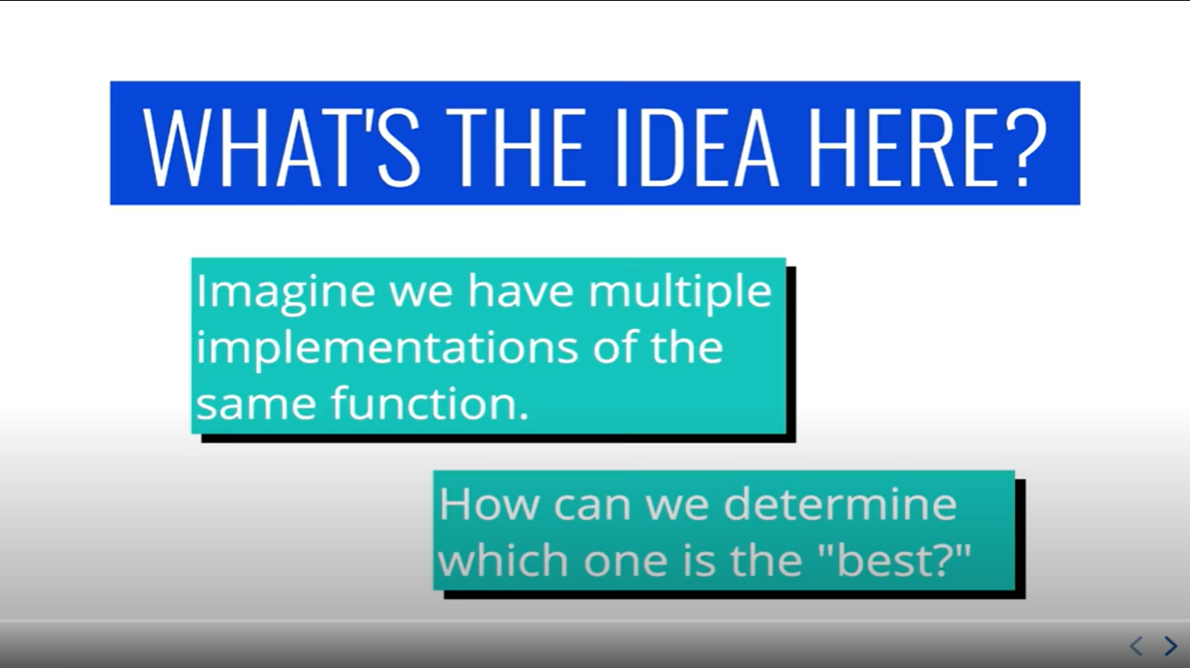

Slide 5
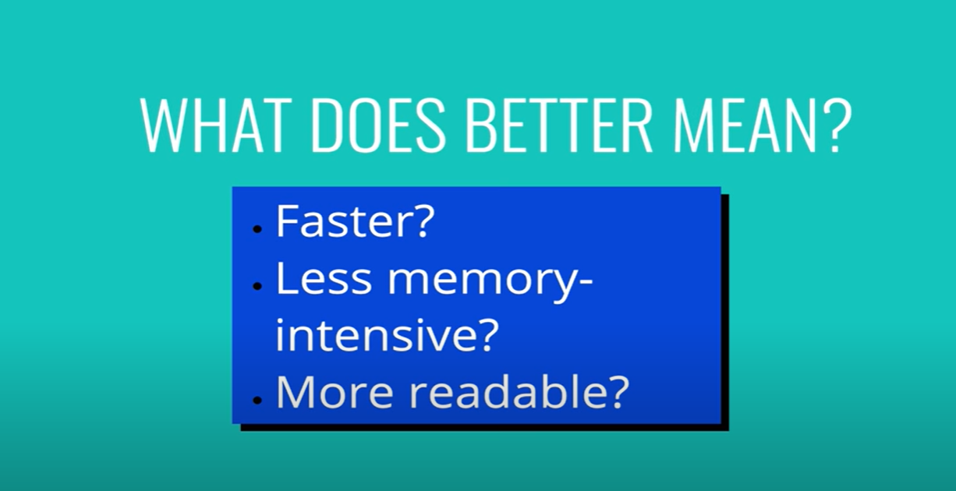

Slide 6
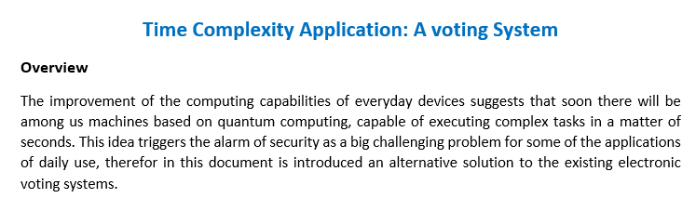

Slide 7
The important aspect of this report is to analyze according to time complexity , the asymptotical behavior of the proposed scheme which incorporates an advanced encryption system which has homomorphic properties that allow performing arithmetic calculations on encrypted text, the system’s security (BGV) relies on a difficult mathematical problem of lattices theory called Learning with Errors (LWE), which was proved to be safe against quantum computer-based attack.

Slide 8
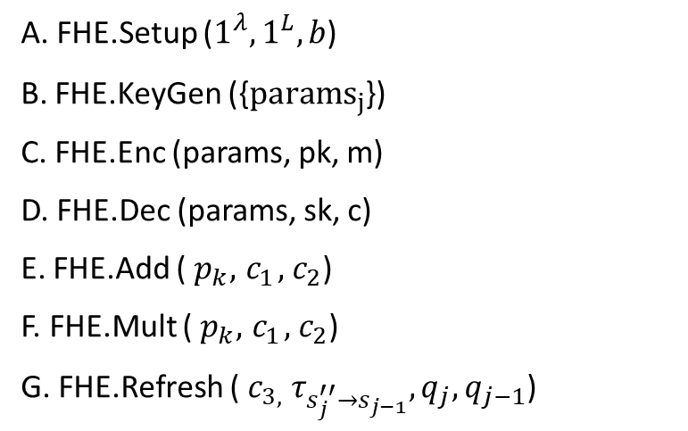
The schema is made up by the following functions:
A. FHE.Setup ($1^{λ},1^{L}, b$)
B. FHE.KeyGen ({${params}_{j}$})
C. FHE.Enc (params, pk, m)
D. FHE.Dec (params, sk, c)
E. FHE.Add (${ p}_{k},{ c}_{1},{ c}_{2}$)
F. FHE.Mult (${ p}_{k},{ c}_{1},{ c}_{2}$)
G. FHE.Refresh (${ c}_{3,} τ_{s_{j}^{′′}→s_{j−1}}, q_{j},q_{j−1}$)

Slide 9
Block Diagram of the System

Slide 11
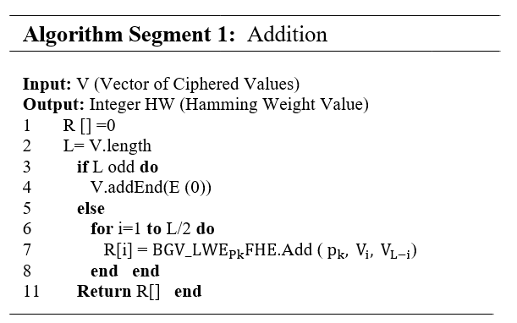

Slide 12
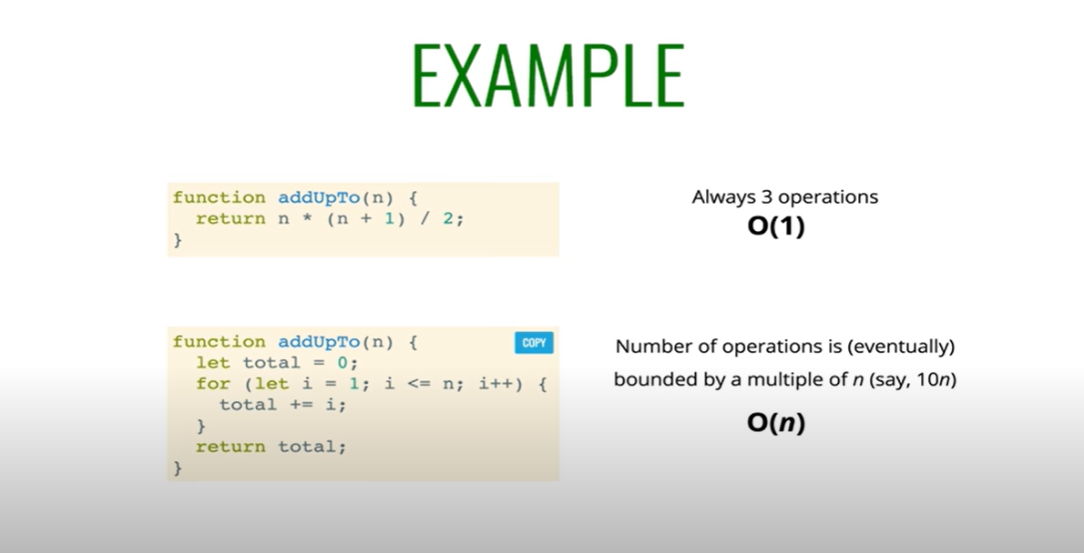
This is a linear function!

Slide 13
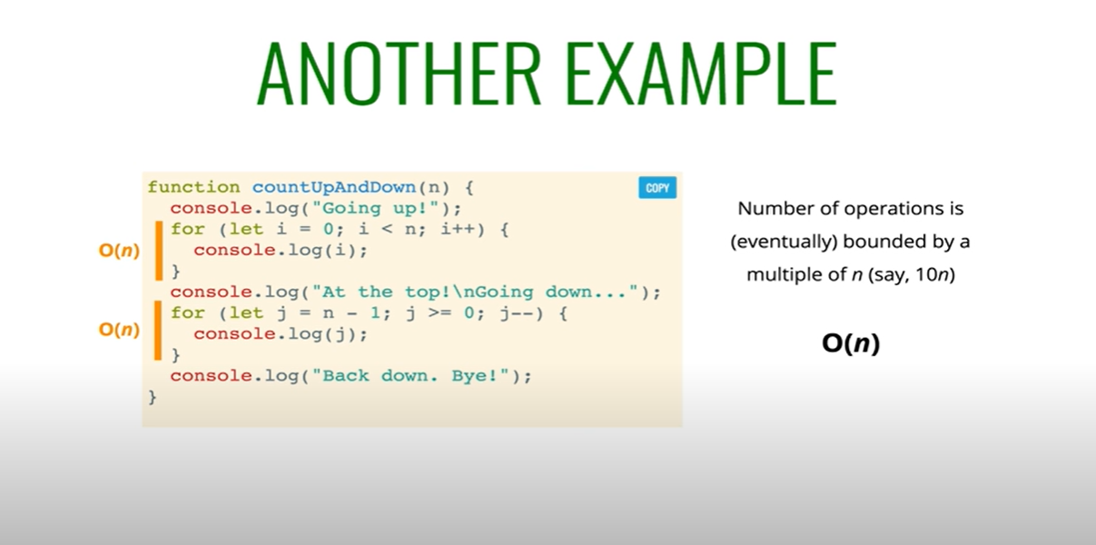
By this way it was determined that our algorithm has a linear asymptotical behavior.. Confirmed practically later

Slide 14
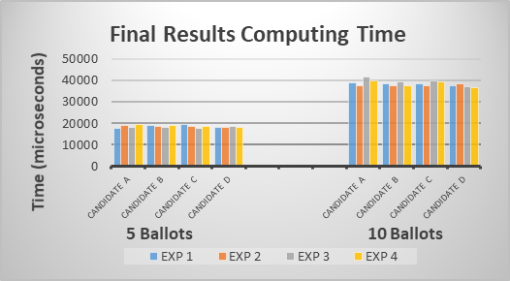

Slide 15
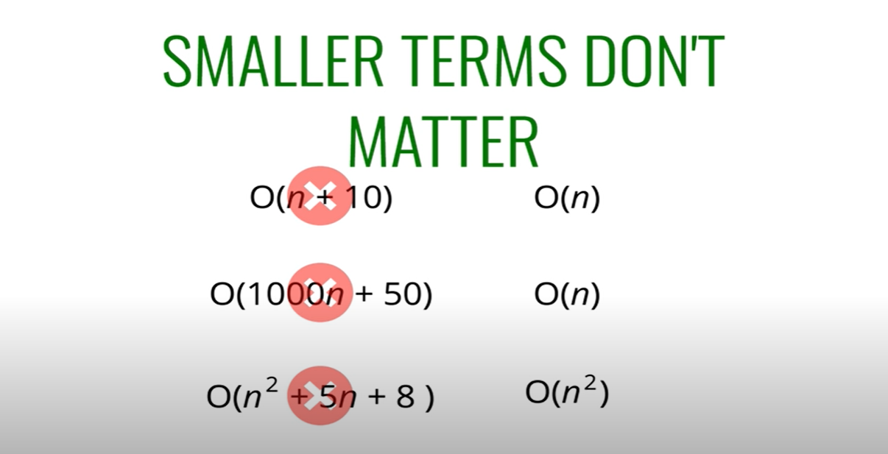

Slide 16
Properties of the Lattice-Based Signature Scheme
Scheme | Sign size | Pk size | Sk size
DS_LWE | O(n log n) | O(n log n) | O(n log n)

Slide 17
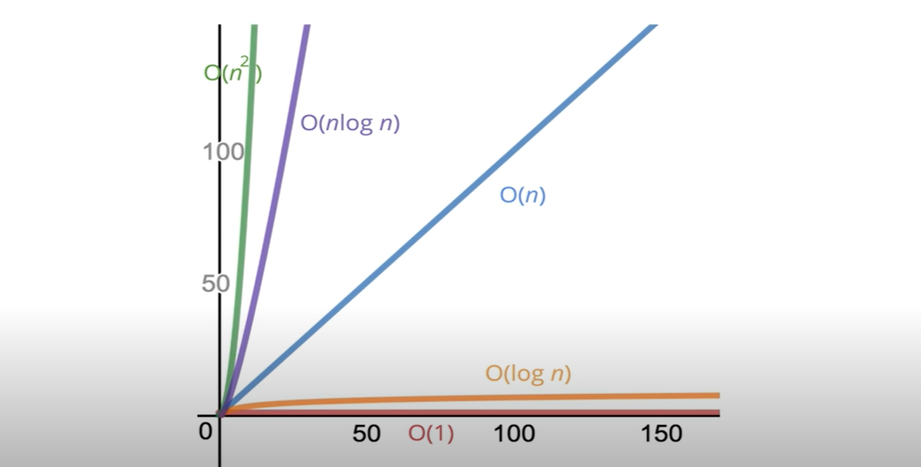
https://github.com/joseluisnaranjo/HEVotingSystem

Slide 18

The end

